Slide 1
ANALYZING HOTEL BOOKINGS A Deep Dive into Cancellation Behavior & Guest Loyalty
Presented by: Mohamed Reda

Slide 2
Objective:
Analyze hotel booking behavior to reduce cancellations
and enhance guest experience.
Dataset:
- 36,285 bookings.
- Key fields: lead time, repeated guests, market type, cancellation status

Slide 3
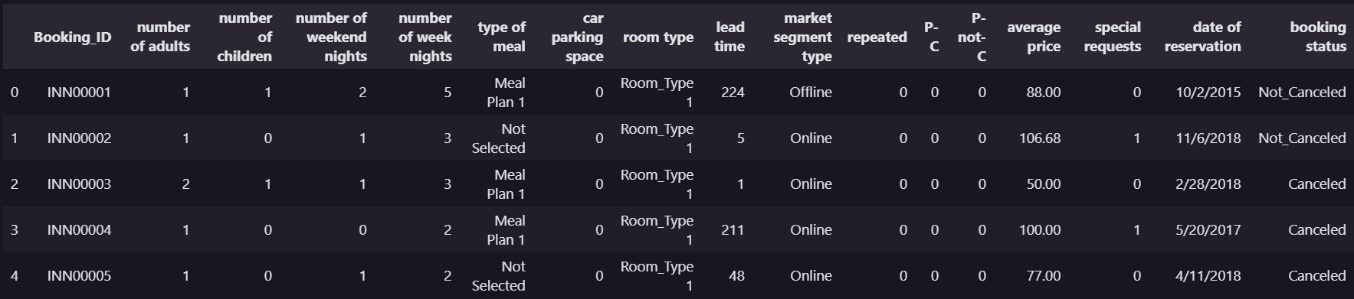
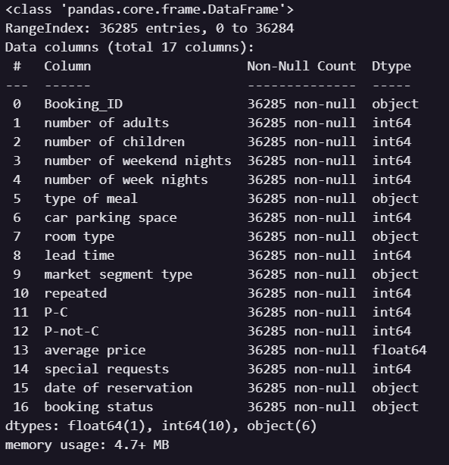
Let's start with understanding what we're working with.
The dataset contains detailed information on 36,285 hotel bookings. It includes variables related to guest behavior, booking channels, pricing, and cancellation outcomes.

Slide 4
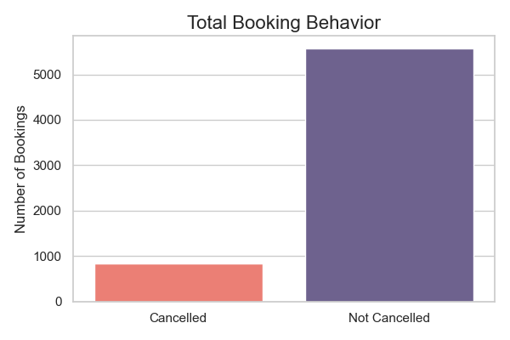
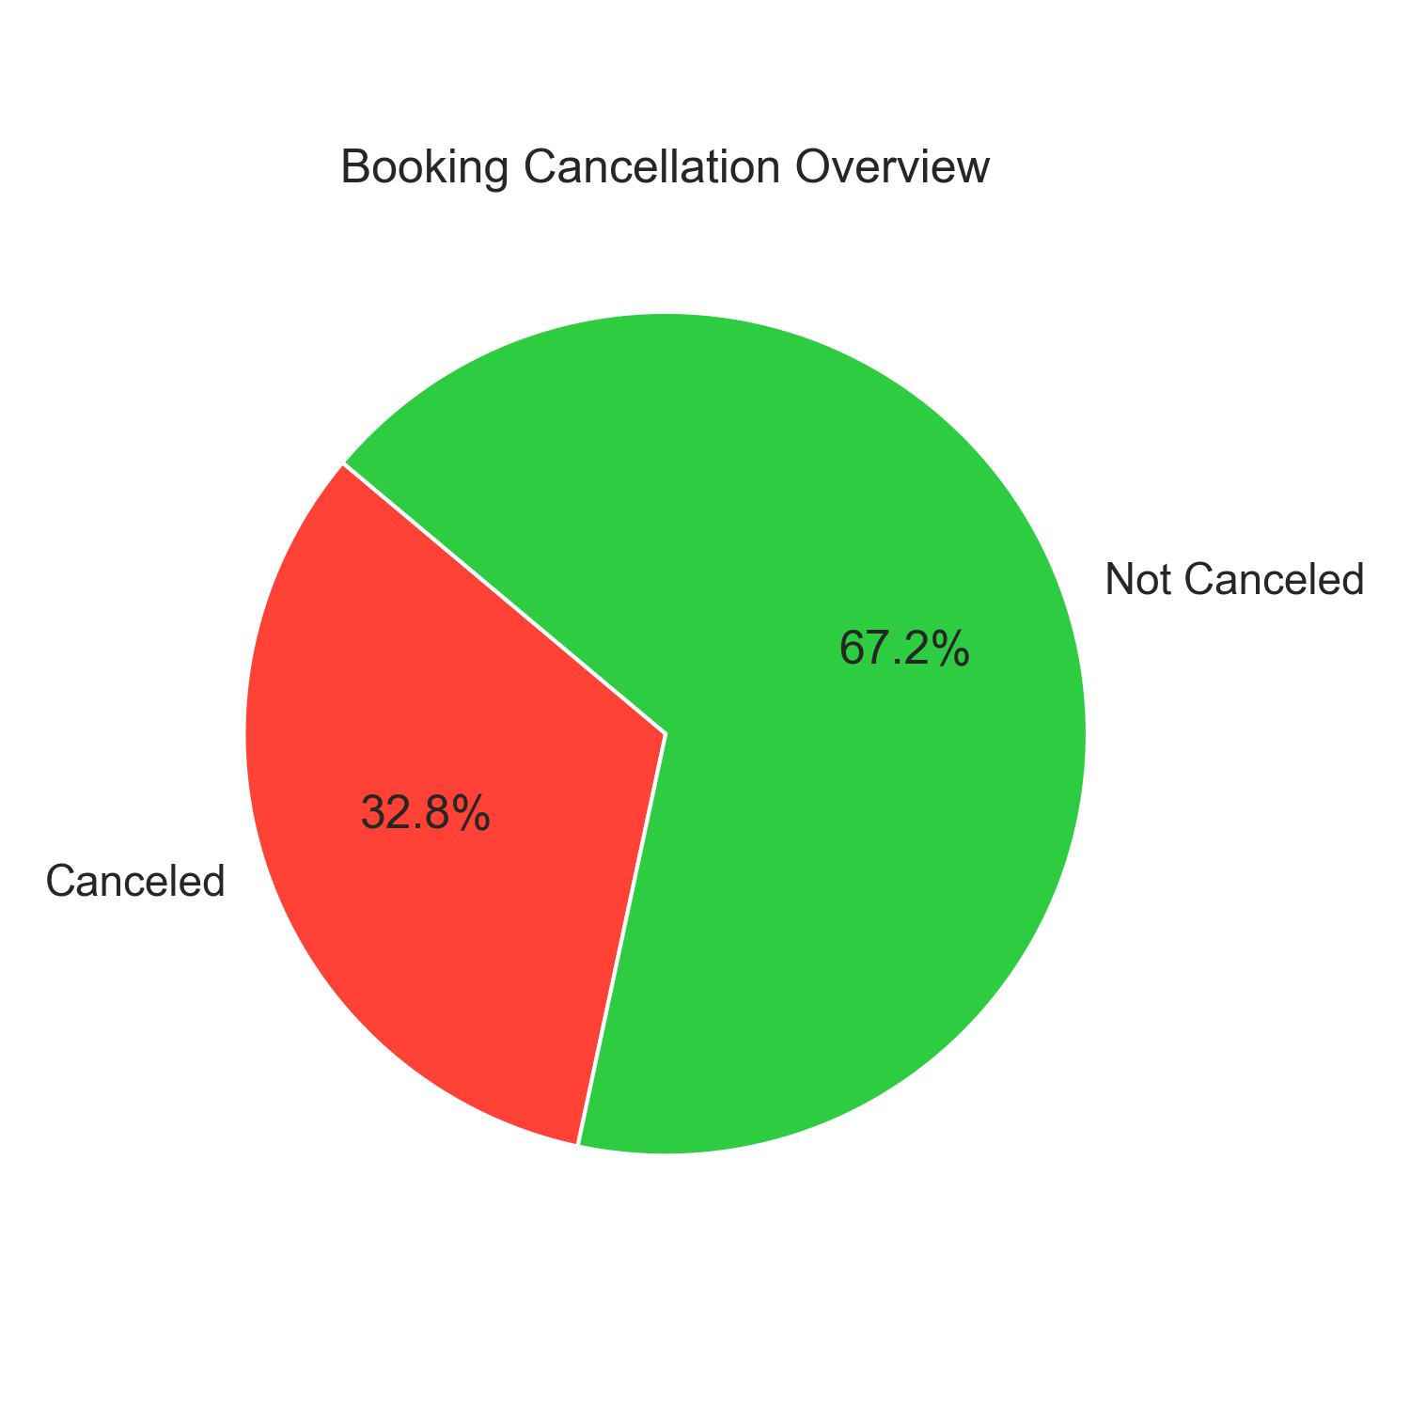
Out of 36,285 bookings, 11,830 were canceled — that’s roughly 🟥 32.6% cancellation rate
This insight is critical for understanding guest commitment and improving retention strategies.

Slide 5
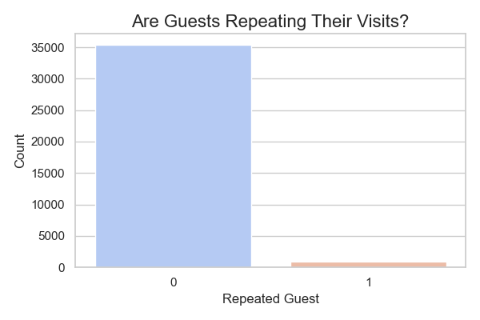
Guest Loyalty – Repeated vs First-Time Bookers
Most guests are first-time visitors.
Could loyalty programs reduce cancellations?
📌Repeated guests are less likely to cancel. Consider implementing loyalty perks to improve retention and reduce booking risk.
“The majority of hotel bookings are made by first-time guests. However, repeated guests are a valuable segment — less likely to cancel and more likely to return.”

Slide 6
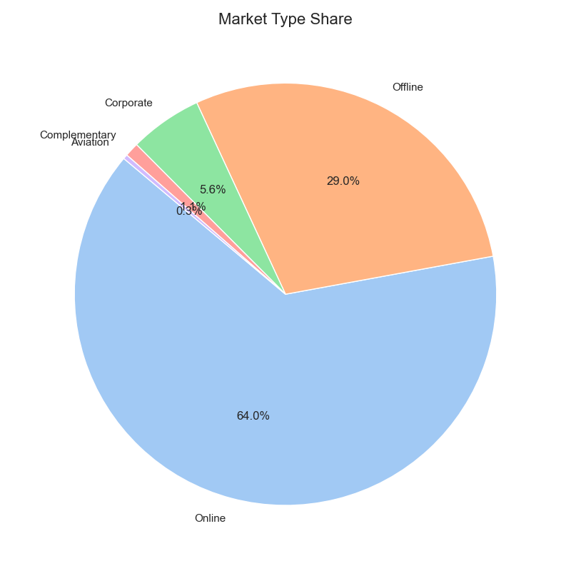
Where Are Guests Coming From?
Understanding how bookings are made gives us insight into guest intent and behavior. Guests come through multiple channels — some with higher cancellation risk than others.
Market segment type reflects the booking source:
🖥️ Online
🧾 Offline
✈️ Aviation
🏢 Corporation
🎁 Complimentary

Slide 7
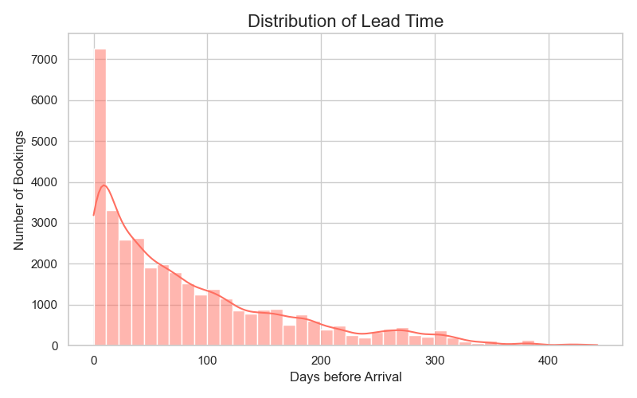
How Early Do Guests Book?
The lead time measures the number of days between when a guest books and when they actually arrive. It’s a crucial factor in predicting cancellations.
- Most guests book within the first 0–50 days.
- A noticeable portion book months in advance.
- These long lead times might signal low commitment or more cancellations.
💡 Most bookings happen within 0-50 days of arrival. However, guests who book far in advance tend to cancel more often.

Slide 8
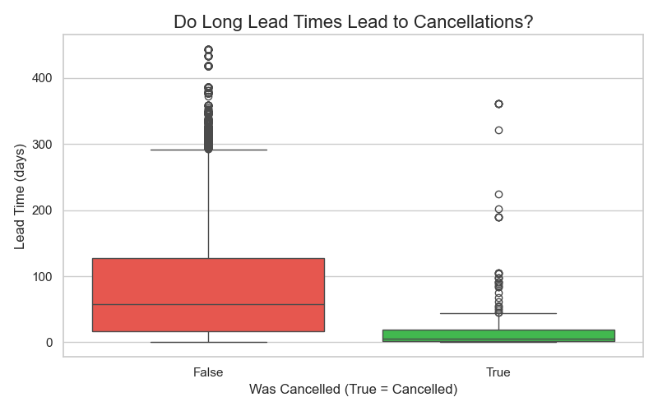
Do Early Bookers Cancel More?
Now that we know when guests typically book, let’s analyze whether lead time affects cancellation likelihood.
Guests who book far in advance often have a higher risk of canceling.
Guests with shorter lead times are more likely to show up.
This insight could help set refundable/non-refundable pricing policies.

Slide 9
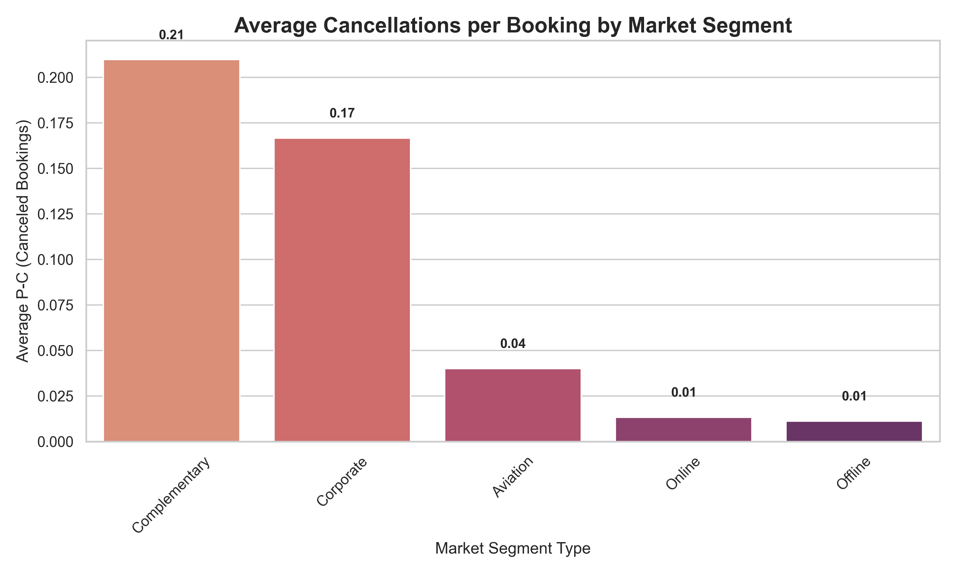
Which Booking Sources Cancel the Most?
Not all booking sources are equal some channels are more prone to cancellations than others.
This bar chart shows the average number of cancellations per booking for each market segment.
This chart shows the average number of cancellations (P-C) per market segment
Complimentary bookings stand out as the most unstable
Aviation also shows high cancellation frequency
Online & offline bookings are more stable by comparison

Slide 10
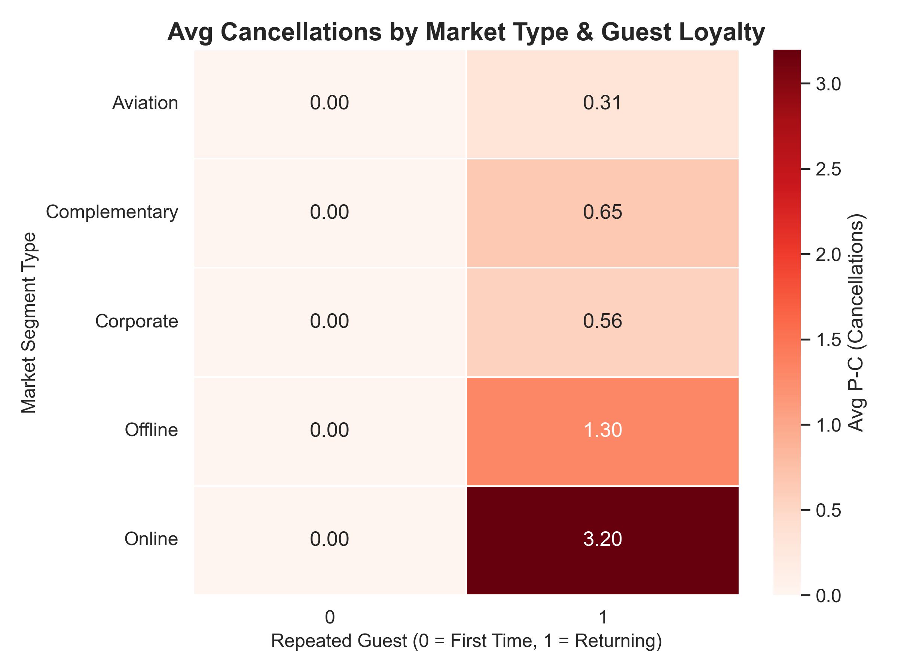
Does Booking Early Predict Cancellation?
We already saw that longer lead times often mean more cancellations, but how exactly does that relationship look across the timeline?
This analysis segments bookings by lead time buckets.
Then compares cancellation rate per bucket.
TL;DR: The further out people book, the less likely they are to commit.

Slide 11
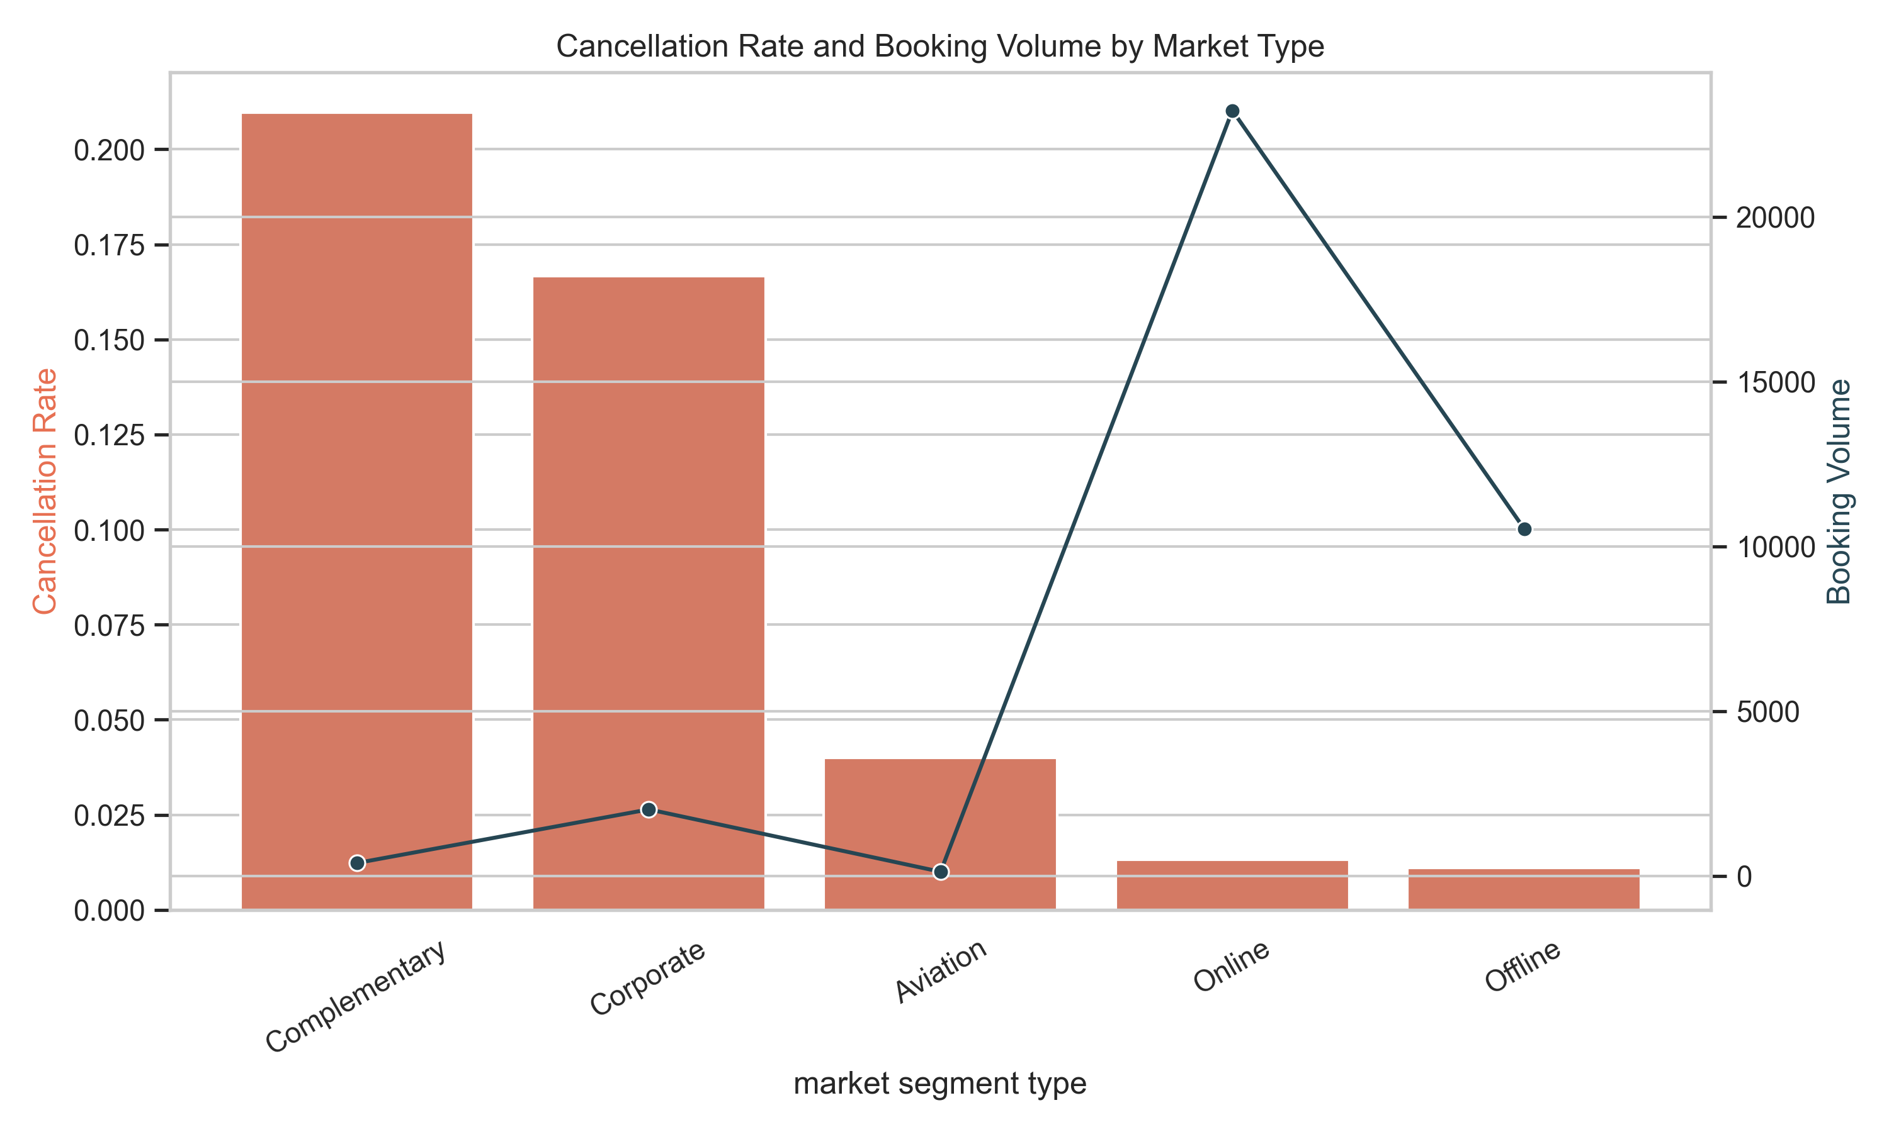
Who Cancels the Most vs Who Books the Most?
Some booking sources cancel a lot, others bring in consistent revenue.
This plot compares:
“❌ Average cancellations (P-C) → risk”.
“✅ Successful bookings (P-C) → value”.
- Understanding both helps us identify high-risk low-value segments, and focus on high-value loyal sources.
- Use a combo chart:
Bar chart → avg(P-C) per market segment type.
Line (on secondary y-axis) → count(P-not-C) per segment.
📍 X-axis: Market Segment Type 📍 Left Y-axis: Avg Cancellations (Risk) 📍 Right Y-axis: Successful Bookings (Value)

Slide 12
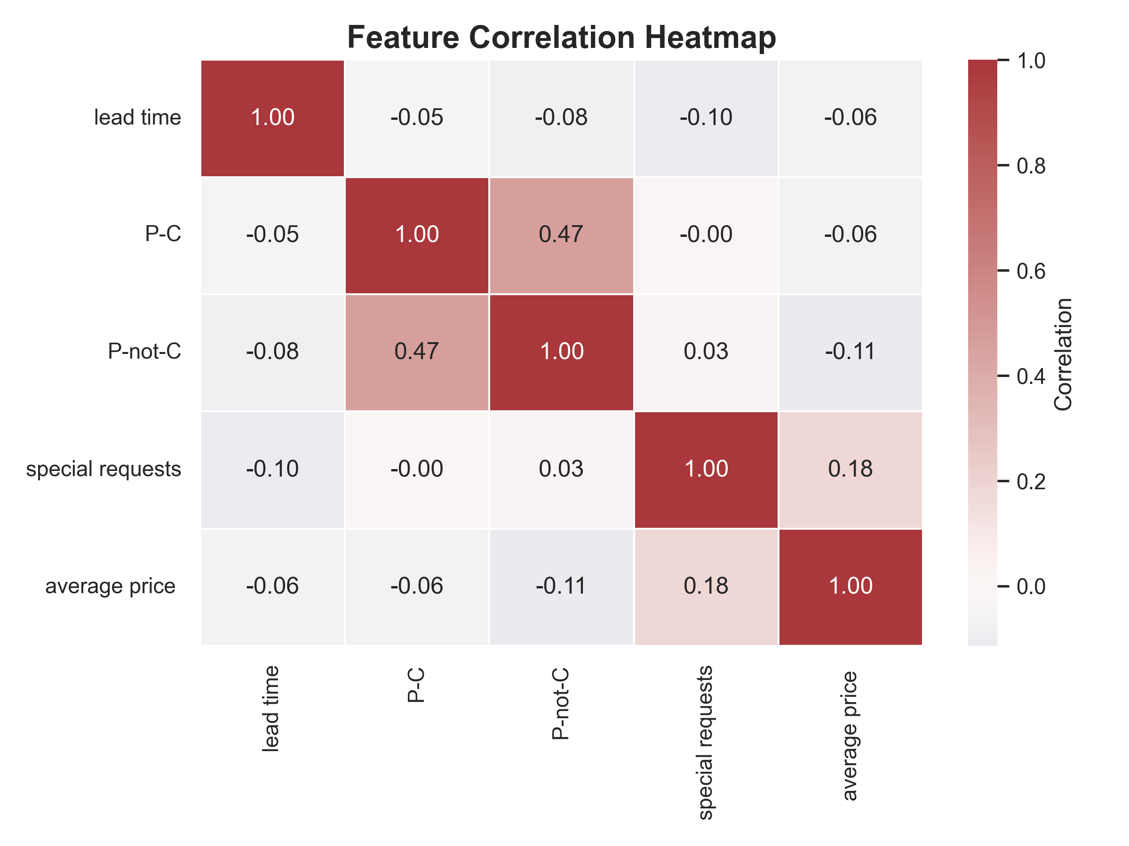
How Do Our Features Relate to Each Other?
This heatmap shows the correlation between numerical features in our dataset. Correlation values range from:
+1 → perfect positive relationship
–1 → perfect negative relationship
0 → no correlation
💡 Lead Time and Cancellations (P-C) are positively correlated.
“More lead time → higher chance of cancellation”
Special requests show a weak negative correlation with cancellations
possibly indicating committed guests.

Slide 13
What Did We Learn? — Insights that Matter
✔️ Guests with long lead time are more likely to cancel
✔️ Complimentary & Aviation bookings have the highest average cancellations
✔️ Repeated guests cancel significantly less
✔️ Corporate & Online market segments are the most reliable
✔️ Special requests show commitment (correlate negatively with cancellations)
💡 Loyalty and timing are key drivers of cancellations.
Targeting the right guests at the right time leads to more stable revenue.

Slide 14
Thank You!

